Slide 1
Accelerators
Accelerated systems.
System design:
  performance analysis;
  scheduling and allocation.

Slide 2
Accelerated systems
Use additional computational unit dedicated to some functions?
  Hardwired logic.
  Extra CPU.
Hardware/software co-design: joint design of hardware and software architectures.

Slide 3
Accelerated system architecture
accelerator
request
CPU
result
data
data
memory
I/O

Slide 4
Accelerator vs. co-processor
A co-processor executes instructions.
  Instructions are dispatched by the CPU.
An accelerator appears as a device on the bus.
  The accelerator is controlled by registers.

Slide 5
Accelerator implementations
Application-specific integrated circuit.
Field-programmable gate array (FPGA).
Standard component.
  Example: graphics processor.

Slide 6
System design tasks
Design a heterogeneous multiprocessor architecture.
  Processing element (PE): CPU, accelerator, etc.
Program the system.

Slide 7
Why accelerators?
Better cost/performance.
  Custom logic may be able to perform operation faster than a CPU of equivalent cost.
  CPU cost is a non-linear function of performance.
cost
performance

Slide 8
Why accelerators? cont’d.
Better real-time performance.
  Put time-critical functions on less-loaded processing elements.
  Remember RMS utilization---extra CPU cycles must be reserved to meet deadlines.
cost
deadline w.
RMS overhead
deadline
performance

Slide 9
Why accelerators? cont’d.
Good for processing I/O in real-time.
May consume less energy.
May be better at streaming data.
May not be able to do all the work on even the largest single CPU.

Slide 10
Accelerated system design
First, determine that the system really needs to be accelerated.
  How much faster is the accelerator on the core function?
  How much data transfer overhead?
Design the accelerator itself.
Design CPU interface to accelerator.

Slide 11
Performance analysis
Critical parameter is speedup: how much faster is the system with the accelerator?
Must take into account:
  Accelerator execution time.
  Data transfer time.
  Synchronization with the master CPU.

Slide 12
Accelerator execution time
Total accelerator execution time:
  t_{accel} = t_{in} + t_{x} + t_{out}
Data input
Data output
Accelerated
computation

Slide 13
Data input/output times
Bus transactions include:
  flushing register/cache values to main memory;
  time required for CPU to set up transaction;
  overhead of data transfers by bus packets, handshaking, etc.

Slide 14
Accelerator speedup
Assume loop is executed n times.
Compare accelerated system to non-accelerated system:
  S = n(t_{CPU} - t_{accel})
  = n[t_{CPU} - (t_{in} + t_{x} + t_{out})]
Execution time on CPU

Slide 15
Single- vs. multi-threaded
One critical factor is available parallelism:
  single-threaded/blocking: CPU waits for accelerator;
  multithreaded/non-blocking: CPU continues to execute along with accelerator.
To multithread, CPU must have useful work to do.
  But software must also support multithreading.

Slide 16
Total execution time
Single-threaded:
Multi-threaded:
P1
P1
P2
A1
P2
A1
P3
P3
P4
P4

Slide 17
Execution time analysis
Single-threaded:
  Count execution time of all component processes.
Multi-threaded:
  Find longest path through execution.

Slide 18
Sources of parallelism
Overlap I/O and accelerator computation.
  Perform operations in batches, read in second batch of data while computing on first batch.
Find other work to do on the CPU.
  May reschedule operations to move work after accelerator initiation.

Slide 19
Accelerated systems
Several off-the-shelf boards are available for acceleration in PCs:
  FPGA-based core;
  PC bus interface.

Slide 20
Accelerator/CPU interface
Accelerator registers provide control registers for CPU.
Data registers can be used for small data objects.
Accelerator may include special-purpose read/write logic.
  Especially valuable for large data transfers.

Slide 21
Caching problems
Main memory provides the primary data transfer mechanism to the accelerator.
Programs must ensure that caching does not invalidate main memory data.
  CPU reads location S.
  Accelerator writes location S.
  CPU writes location S.
BAD

Slide 22
Synchronization
As with cache, main memory writes to shared memory may cause invalidation:
  CPU reads S.
  Accelerator writes S.
  CPU reads S.

Slide 23
Partitioning
Divide functional specification into units.
  Map units onto PEs.
  Units may become processes.
Determine proper level of parallelism:
f1()
f2()
f3(f1(),f2())
vs.
f3()

Slide 24
Partitioning methodology
Divide CDFG into pieces, shuffle functions between pieces.
Hierarchically decompose CDFG to identify possible partitions.

Slide 25
Partitioning example
cond 1
cond 2
Block 1
P1
Block 2
P2
Block 3
P4
P5
P3

Slide 26
Scheduling and allocation
Must:
  schedule operations in time;
  allocate computations to processing elements.
Scheduling and allocation interact, but separating them helps.
  Alternatively allocate, then schedule.

Slide 27
Example: scheduling and allocation
P1
P2
M1
M2
d1
d2
P3
Task graph
Hardware platform

Slide 28
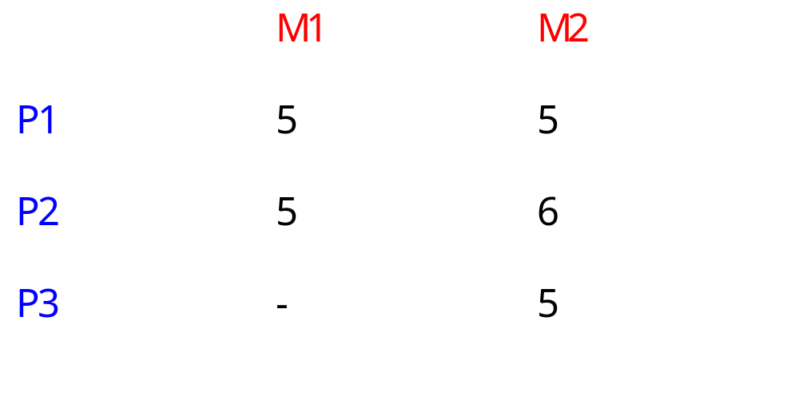
Example process execution times

Slide 29
Example communication model
Assume communication within PE is free.
Cost of communication from P1 to P3 is d1 =2; cost of P2->P3 communication is d2 = 4.

Slide 30
First design
Allocate P1, P2 -> M1; P3 -> M2.
M1
P1
P2
Time = 19
M2
P3
network
d2
5
10
15
20
time

Slide 31
Second design
Allocate P1 -> M1; P2, P3 -> M2:
M1
P1
Time = 18
M2
P2
P3
network
d2
5
10
15
20

Slide 32
System integration and debugging
Try to debug the CPU/accelerator interface separately from the accelerator core.
Build scaffolding to test the accelerator.
Hardware/software co-simulation can be useful.

